Slide 1
The H-P-S-T Framework Workshop
Presented by: Jose M. Pombo; and
Dr Sarah Mathews

Slide 2
What is this Framework?
This framework is primarily for document analysis and can be best described as a pedagogical guide used to interpret and understand historical narrative; producing an authentic learning experience in a history or social studies learning environment.

Slide 3
What does the H-P-S-T stand for?
The aforementioned acronym stands for Historic, Philosophic, Societal, and Takeaway Framework

Slide 4
Purpose of the H-P-S-T Framework:
The H-P-S-T Framework will serve as a guide (for historical document analysis) that when applied to the course’s readings:
1) will help extract content knowledge
2) create higher order connection making,
3) will be used as a platform for student dialogue,
4) could be utilized as a deliverable form of student assessment.
5) provide students will an authentic learning experience
The framework should be primarily offered to pre or in service teachers, as an alternative teaching strategy that can catalyze more learning environment autonomy.
Then, in turn, these educators will pass on this framework to students in their own classes.

Slide 5
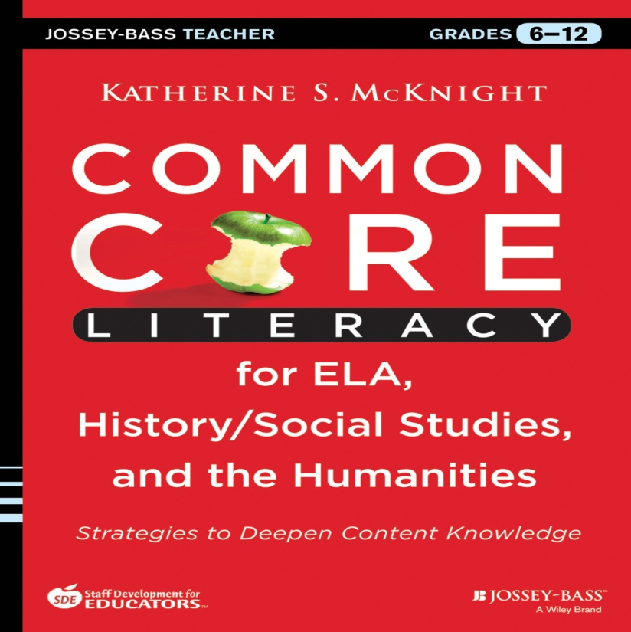
The H-P-S-T Framework and the Common Core: State Standard Initiative.
The Common Core espouses literacy competencies (or standards in the strand) which must be met in the area of history and or social studies. These standards in the strand are based on reading material that is to be analyzed so a greater understanding of content can be achieved. The H-P-S-T Framework will help with this endeavor.

Slide 6
Aligns with MIVCA
The HPST Frameworks is:
a) meaningful- it builds curriculum networks of knowledge, skills, beliefs, and attitudes that are structured around enduring understandings, essential questions, and learning goals;
b) integrated- it draws from history, political science, and sociology to increase the understanding of an event or concept and it provides opportunities for students to conduct inquiry, develop and display data, synthesize findings, and make judgments; and
c) active- students develop new understanding through a process of active knowledge construction via interaction in cooperative group dynamic

Slide 7
What type of narratives can be used?
This framework mainly targets written text (s), but could extend to visual and or auditory narratives as well.

Slide 8
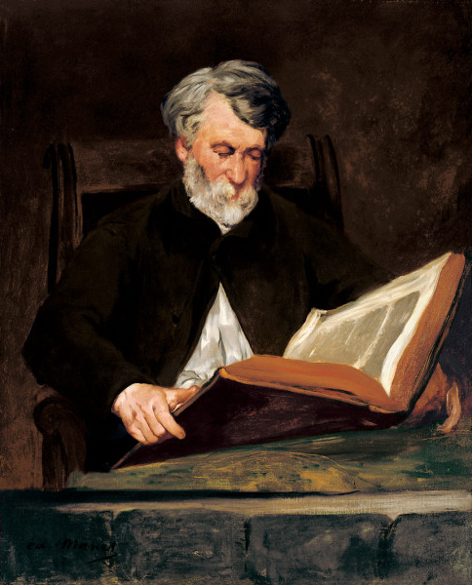
How does the H-P-S-T Framework work?
This framework has two levels. The first is the Interactive Level: which is composed by three interconnected elements, namely the: author, text and reader/student. (refer to 3d model)

Slide 9
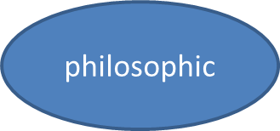
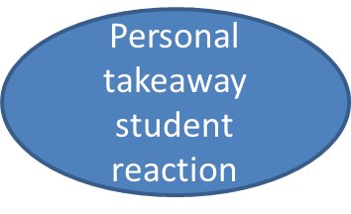
Analytic Level
The second level is the Analytic Level- and is composed by four frames, which are the: Historic, philosophic, societal, and a “personal” takeaway (student reaction)

Slide 10
Pedagogic Application- Example Lesson Plan Step 1: Teacher Preparation
Teacher will determine:
a. Subject Area-Social Studies/History
b. Main topic covered- for this example we chose:
Cuban immigration patterns- specifically the first wave of exiles/ circa: 1959-1970
c. Standards that are appendages of main topic-
Historical Knowledge/ Grade: 2/ Discuss why immigration continues today.
Understand the rise and continuing international influence of the United States as a world leader and the impact of contemporary social and political movements on American life./ Grade: 9-12/ changes in immigration policy and attitudes toward immigration since 1950. Recognize significant events and people from the post World War II and Cold War eras.

Slide 11
Step 2: Historic Text or Literature/Narrative Selection
Teacher should utilize texts/narratives that exemplify the selected topic and should correlate to the desired content.
Chapters from a whole text can also be used
Narrative should be outside of an expository textbook
Either primary and secondary sources can be used
Dueling or deliberating texts preferred (such as: diary of Anne Frank/Mein Kemp) because the Framework can be used as platform for student voice

Slide 12
Example of Text Selection:
In this example, the two texts chosen are:
My Havana: Memories of a Cuban Boyhood written by Rosemary Wells (for lower grades)
Next Year in Cuba authored by Gustavo Perez Firmat (for grades 9-12)

Slide 13
Step 3: Hook Activity
Teacher will create a visual, tactile, and or auditory artifact that will engage and excite students about the selected topic
Refer to the gallery walk concept which can be used as a possible deliverable

Slide 14
Step 4:Student’s Roadmap
The teacher will offer students an introduction to the lesson in the form of a literary roadmap(used to navigate through the reading(s) that highlight or references the desired content). This roadmap is composed of two elements: 1) background on the author (s); and 2) vocabulary, concept, essential question (s), and or terms list

Slide 15
1-background on the author(s): (Roadmap A)
This is composed by listing relevant particulars of the author’s personal/ professional life, and authorship: to include a visual image or picture of the author of text (if available).
Suggestion: This can be done via an in class exercise where students are looking up online particulars and teacher will create a concept map.
This step can serve to further introduce the lesson and help student understand the reading better.

Slide 16
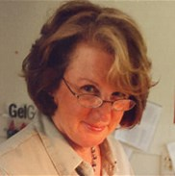
Example One: Roadmap A- Author Background
Rosemary Wells: is an American writer and illustrator of children's books. She is well known for the Max and Ruby series, which follows the everyday adventures of sibling bunnies, curious three-year-old Max and bossy seven-year-old Ruby. Wells has also written Noisy Nora (1973), Yoko (1998), Voyage to the Bunny Planet series, a Christmas book called Morris's Disappearing Bag (1975) and a collected book of illustrations of Rodgers and Hammerstein songs.
Type of text: (My Havana: Memories of a Cuban Boyhood) children’s illustrated book/secondary source

Slide 17
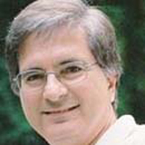
Example Two: Roadmap A-Author Background
Gustavo Perez Firmat:
Text type- (Next year in Cuba) autobiographic /secondary source
Cuban American and is affiliated to Columbia University (Dept of Latin America and iberic culture). The author has written other pieces, namely: Idle Fictions (Duke, 1982; rev. ed. 1993)/The Cuban Condition (Cambridge, 1989; rpt. 2005)/Do the Americas Have a Common Literature? (Duke, 1990)/ Life on the Hyphen (Texas, 1994, Rpt. 1996, 1999; Spanish version: Vidas en vilo, Colibrí, 2000/Revised and expanded edition, 2012)/My Own Private Cuba (Colorado, 1999)/ Cincuenta lecciones de exilio y desexilio (Universal, 2000)/Tongue Ties (Palgrave, 2003)/The Havana Habit (Yale, 2010)/ The Norton Anthology of Latino Literature [Co-editor] (Norton,2010)/ A Cuban in Mayberry: Looking Back at America's Hometown (Texas, forthcoming 2014).

Slide 18
2- Vocabulary, Concepts, Terms List, and or Essential Questions: (Roadmap B)
Can be any one or combination of the above mentioned
should highlighting desired content/ set parameter for the student to follow
Examples:
(Polarization of Power after WWII/Cold War/Fidel Castro/ Cuban Immigration (circa 1959 onwards)
Historic-
Fulgencio Batista/early career
Fidel Castro/before or after revolution
Philosophic-
communism
Societal
social economic level of first wave of Cuban immigrants
creation of enclaves in USA (Miami)

Slide 19
Step 5: Group Assignment
Can be done either of two ways:
1) Create an historic, philosophic, and or a societal group where all the members of the particular cohort are the same
(h group/p group/s group)
or
2) create a group with one student covering each of the frames
(h/p/s in one group)
All students regardless of group must offer a takeaway

Slide 20
Step 6: reading of text (s)
All students will do reading of text (either in house or at home) highlighting important occurrences
Students must keep their assigned frame in mind

Slide 21
Step 7: Analytic Level: Historic Frame
It is imperative that the teacher embrace (and transmit to his or her students) that this frame is based on an Historiographical Approach. This entails the presentation of history (as exemplified in the historic text) based on its critical examination, evaluation, and interpretation leading to student understanding
The who, what, where, and how are explored. Moreover, student will identify the Four Cs: context, causes, continuity, and change over time (if applicable).
Timelines

Slide 22
Student working in this assigned group will create a deliverable using both the selected excerpts from the historical narrative itself and outside sources (i.e. visuals, tactile, and or auditory artifacts) that describe, exemplify, answer, and or justify the content reflected in student’s Roadmap B for the historic frame.

Slide 23
Example one: historic
referring to student’s roadmap: 1) Fulgencio Batista-
“Once in awhile… the President of Cuba, General Fulgencio Batista, and his followers came to eat at my father’s restaurant. Mami never sends a bill to their table…. Send over the check please Pillar …Papi insists to my mother…they can pay the tab like everyone else….. those fat sons of a sow… but my mother is careful… don't ask for trouble…. she says and allowed Batista and his friends to eat and drink for nothing…. Oh Batista…says Alfonso…when I asked him why my parents are so afraid of El Presidente… he replies…he is friends with all the Mafia crooks you know…and he just took over as president one day””
direct quote from-
My Havana: Memories of a Cuban Boyhood
Rosemary Wells

Slide 24
Example two: historic
referring to student’s roadmap: 2) Fidel Castro:
“Fidel is a rich man son Dino… Papi whispers to me… He went to the best private school in Havana , but he's trying to look like a poor peasant… everyone thinks he's Robin Hood sent from heaven to save Cuba… He calls himself El Lider”
direct quote from-
My Havana: Memories of a Cuban Boyhood
Rosemary Wells

Slide 25
Analytic Level: Philosophic Frame
Within this frame, students will be exploring the belief (s) of a time period, school (s) of thought, public opinion, psychological paradigm, and or “-isms” etc.
Student working in this assigned group will create a deliverable using both the selected excerpts from the narrative itself and outside sources (i.e. visuals and or auditory artifacts) that exemplify, describe, answer, and or justify the content reflected in student’s Roadmap B philosophic frame.

Slide 26
Example one: philosophic
referring to student’s roadmap: 1)communism- “Fidel's compadre Che Guevara promises that all rents in Cuba will be reduced and all wages will be increased…Papi says… Everything in Cuba will be evenly divided and given to the people… No rich no poor everyone the same…Cuba will be like heaven on earth. What nonsense!”
direct quote from-
My Havana: Memories of a Cuban Boyhood
Rosemary Wells

Slide 27
Analytic level: Societal Frame
Students will discuss the underpinnings and cultural nuances of the period. Possible topic can be food, religion, traditions, morals, and values etc.
Student working in this assigned group will create a deliverable using both the selected excerpts from the narrative itself and outside sources (i.e. visuals and or auditory artifacts) that exemplify, describe, answer, and or justify the content reflected in student’s roadmap b societal frame

Slide 28
Example one: societal
referring to student’s roadmap: 1) social economic level of first wave of Cuban immigrants
“With her jewelry my mother had better luck. After she had covered it with nail polish (I have never quite understood how this paint job was supposed to work) the friend at the embassy offer to smuggle the most valuable pieces out of Cuba… My mother hatched a plan which she must have gotten from a Hollywood movie… she put the jewelry (covered in nail polish… in a purse and went to El Carmelo Restaurant …where she was met there by the their friend’s secretary…. In the ladies room the exchange purses…. several weeks later in Miami…. she received two packages in the mail… although stamped in the United States…. they brought no return address…. inside where her nail polished earrings and bracelets”
Direct quote from-
Next year in Cuba
Gustavo Perez Firmat:

Slide 29
Example two: societal
referring to student’s roadmap: 1) social economic level of first wave of Cuban immigrants
“Only a few days before, we had been rich Cubans; now we were homeless and penniless exiles”
Direct quote from-
Next year in Cuba
Gustavo Perez Firmat

Slide 30
Example three: societal
referring to student’s roadmap: 2) creation of enclaves in USA
“Miami 1960-1961… We got off the ferry on the morning of October 25th….where we were met by my parents friends Arturo and Orquidea…we drove over the miles of bridges that connect the Florida Keys to the mainland…finally arriving in Miami and checking in the Lemington Hotel in the downtown area…which was a modest four story hotel built in the 1920s…. it was across the Greyhound bus station and only a short walk from the Gesu Catholic Church…after nearly a month at the Lemington… my father put down $1,900 down payment on a house near Coral Gables in the area later called by Cuban as LA saguesera.......”
Direct quote from-
Next year in Cuba
Gustavo Perez Firmat:

Slide 31
Step 8- Feedback
Once students have completed the above mentioned task in their assigned cohorts; teacher can reconvene, evaluate and debrief the students’ roadmaps and chosen excerpts from the text literature (including any other visual, tactile, and or auditory artifacts) and give them feedback or refocus (if necessary).

Slide 32
Step 9- Takeaway
student reaction
Most important part of lesson
Where actual authentic learning occurs
Every student regardless of cohort MUST react and connect the relevance of what they have learned from the Framework’s steps to their lives in today’s world. These takeaways will be included in final alternative/narrative presentation or deliverable.
This step can give the student an active and participatory voice
Platform for student voice

Slide 33
Step 10- The Knowledge Showcase
This last step will yield a final presentation (or parallel narrative) composed by the bringing together and exhibiting all the analysis and artifacts cohorts found in their research which is to include the individual takeaway
Deliberation/dueling/compare and contrast may occur
(final teacher assessment)

Slide 36
References:
Hermeneutics:
https://www.youtube.com/watch?v=woQEXuH_0GA
Wells, R. (2010)My Havana: Memories of a Cuban Boyhood. Somerville, Massachusetts: Candlewick Press.
Perez Firmat, G. (1995) Next Year in Cuba. New York, New York: Anchor Press.
Que Pasa USA episodes
http://www.quepasausa.org/home/

